Slide 1
Clique Percolation & Link Clustering
Fatih Orhan

Slide 2
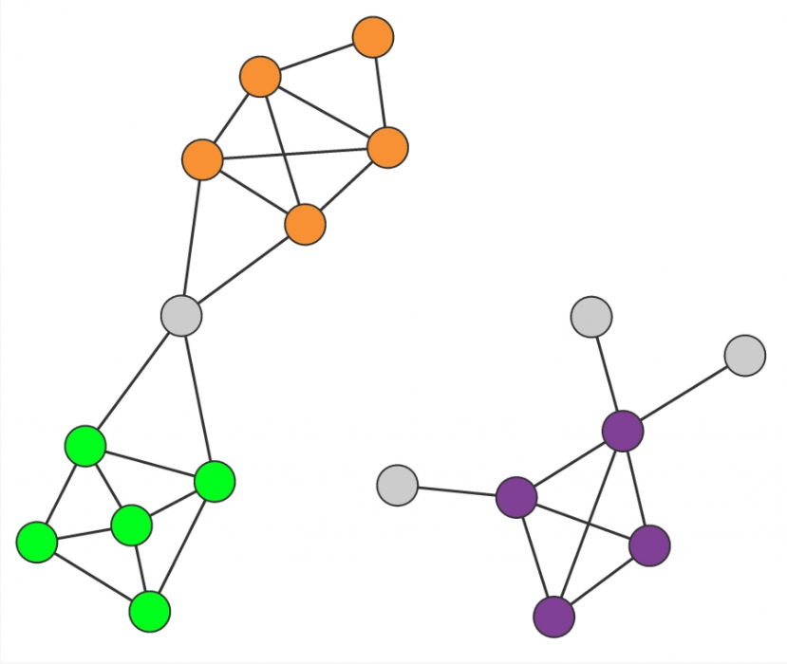
Definitions Before The Problem
Clique: A subgraph with every node connected to all other nodes.
Community: A group of nodes that have a higher likelihood of connecting to each other than to nodes from other communities. More formally, a subgraph with more in-degree than out-degree.

Slide 3
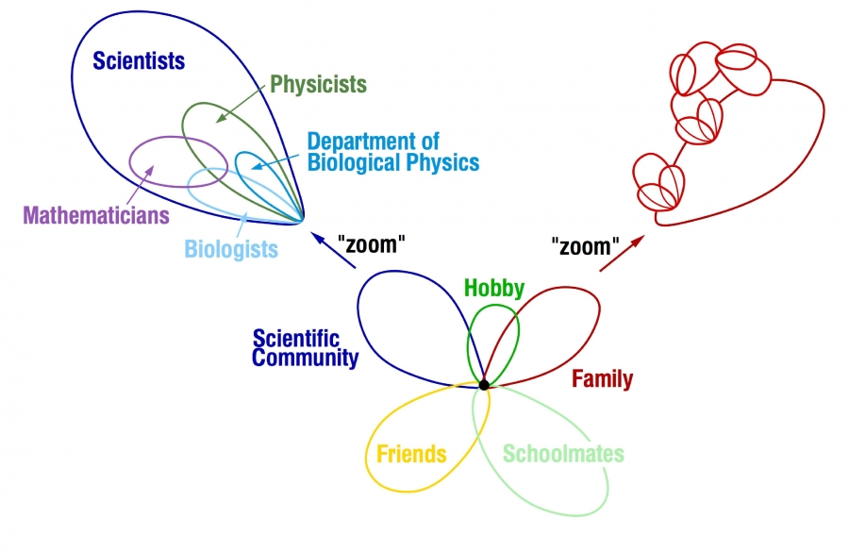
Problem Statement
Given a large network, how can we efficiently find the overlapping communities?
A community is a connected subgraph with semantic meaning (e.g. family, scientists, fishers).
Nodes are oftentimes in multiple communities. For example a scientist also is in a family.

Slide 4
Clique Percolation Algorithm
If two k-cliques share k-1 nodes, they are called adjacent.
A k-clique community is the largest connected subgraph obtained by the union of all adjacent k-cliques
k-cliques that can not be reached from a particular k-clique belong to other k-clique communities

Slide 5
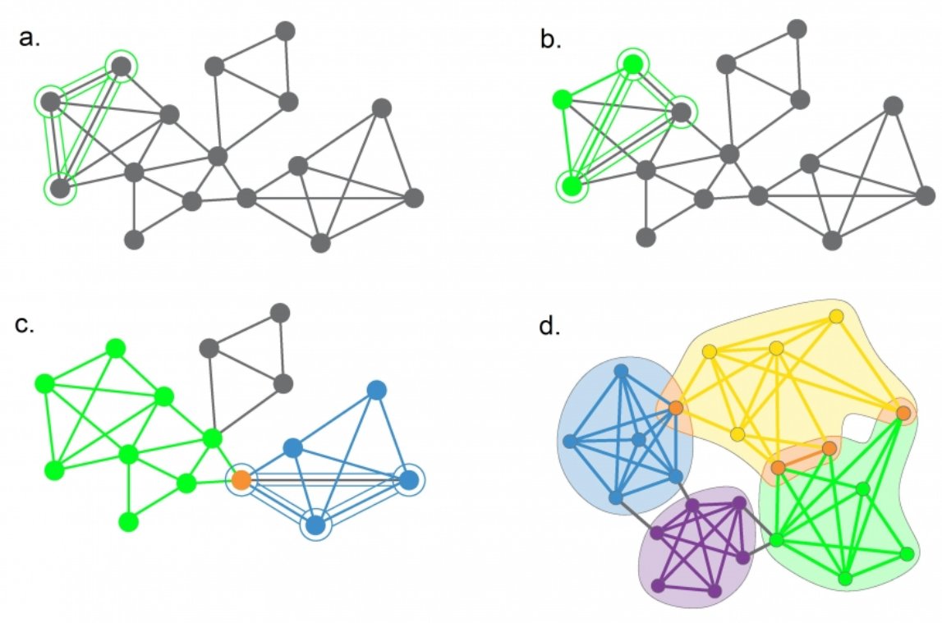

Slide 6
What Are The Odds?
We should also consider whether it’s possible for the communities found to have no meaning and they emerged coincidentally. Below is the threshold to decide the randomness.
Subcritical Communities: p < p_c(k)
Supercritical Communities: p > p_c(k)

Slide 7
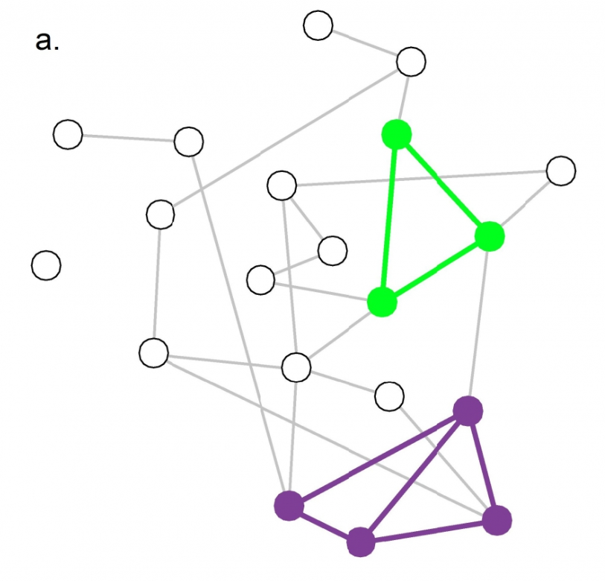
Network to the left is randomly created with p = 0.13. 3-clique threshold is 0.16. Therefore, we don’t observe big communities.

Slide 8
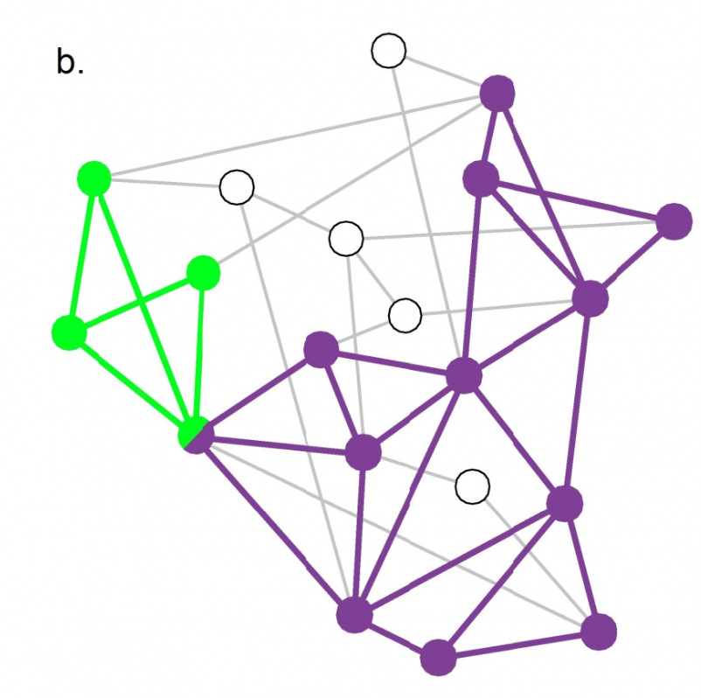
This network has p = 0.22 > 0.16. Therefore, we observe big communities created by 3-cliques randomly.

Slide 9
k-clique communities naturally emerge in sufficiently dense networks. Consequently, to interpret the overlapping community structure of a network, we must compare it to the community structure obtained for the degree-randomized version of the original network.

Slide 10
Complexity
Finding max. Cliques is an NP-Complete problem.
CFinder, however, does not find the max cliques. Instead, it finds smaller cliques and finds communities by taking union. Hence, CFinder is a polynomial-time algorithm.
If there are large cliques in the network, it is more efficient to identify all cliques using an exponential algorithm. Despite this high computational complexity, the algorithm is relatively fast, processing the mobile call network of 4 million mobile phone users in less then one day.

Slide 11
Link Clustering
Links are community-specific. For example, a link between two nodes may be indicating they belong to the same family.
Leveraging this property of the links, link clustering algorithm finds the communities of a network.

Slide 12
Link Clustering
Similarity of links can be defined as follows.
n_+(i) indicates the set of neighbors of node i.

Slide 13
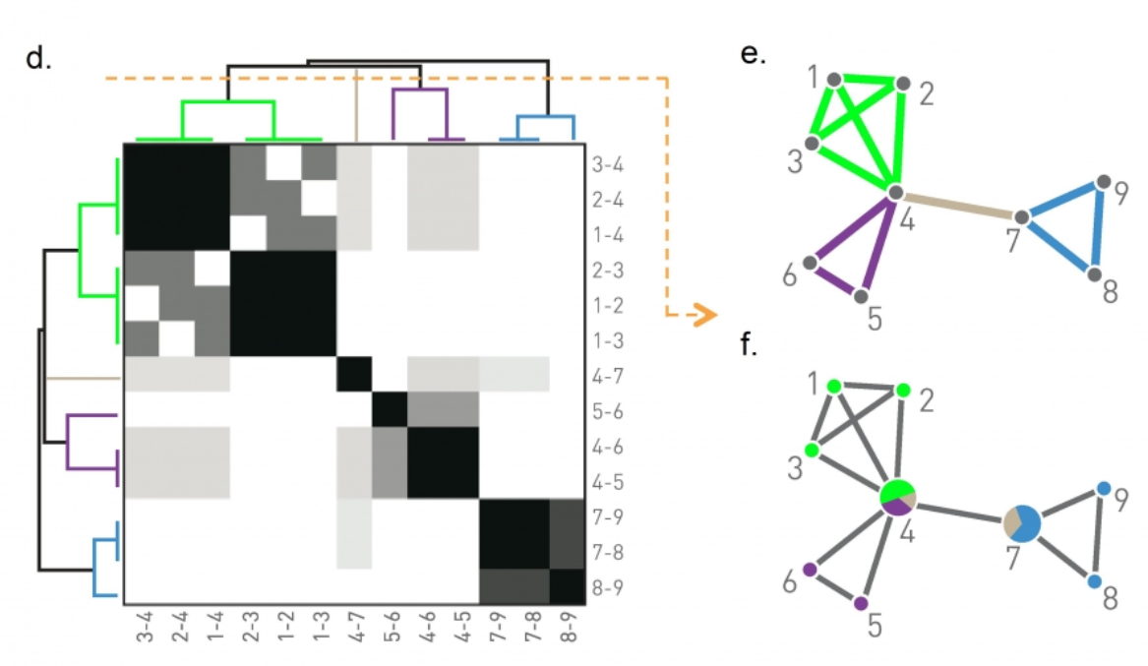

Slide 14
Link Clustering
The algorithm creates a similarity matrix of edges using a similarity function inspired by Ravasz Algorithm (e.g. average link count between 2 communities).
We then apply hierarchical clustering to this matrix to extract the communities.

Slide 15
Link Clustering On Action
The network of characters in Victor Hugo’s 1862 novel Les Miserables. Two characters are connected if they interact directly with each other in the story. The link colors indicate the clusters, light grey nodes corresponding to single-link clusters. Nodes that belong to multiple communities are shown as pie-charts, illustrating their membership in each community. Not surprisingly, the main character, Jean Valjean, has the most diverse community membership.

Slide 16
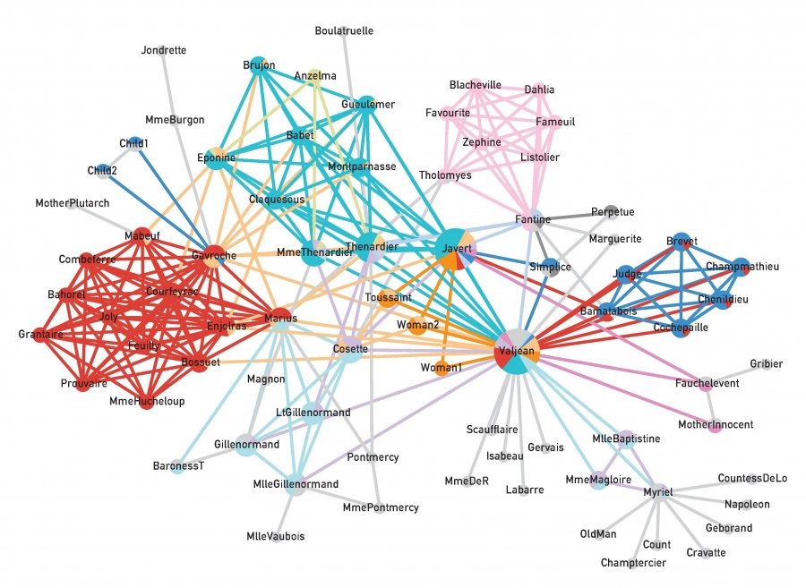

Slide 17
Complexity & Conclusion
Link clustering has quadratic complexity in terms of the number of nodes.
We showed 2 algorithms for detecting overlapping communities. These algorithms’ main point is the hypothesis that nodes in a network oftentimes belong to different communities denoted by community-specific links.

Slide 18
References
Barabási Albert-László. Network Science. Cambridge University Press, 2016.
G. Palla, A.-L. Barabási, and T. Vicsek. Quantifying social group evolution. Nature, 446:664-667, 2007.

